Slide 1
ONLINE CLASS
GRAPH THEORY
BICTE $6^{TH}$ SEMESTER
2078/03/22
PRESENTED BY KALYAN DAHAL

Slide 2
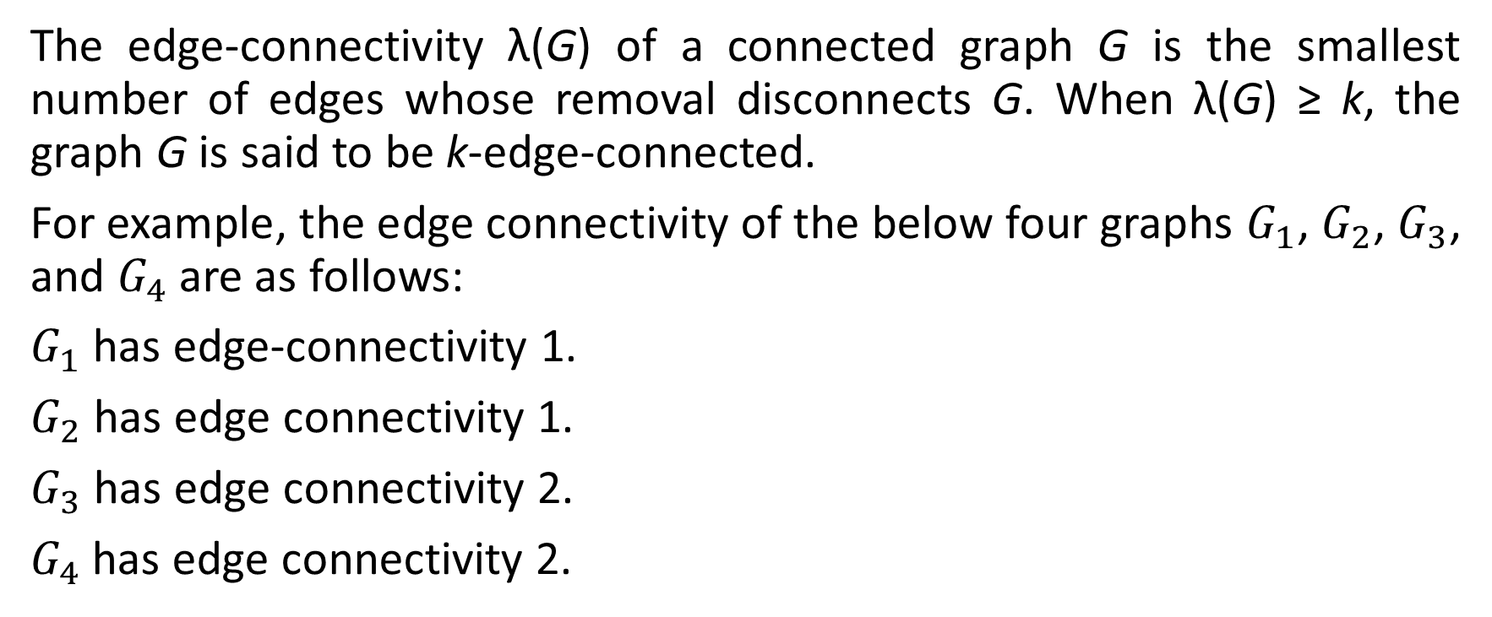
Edge Connectivity
The edge-connectivity λ(G) of a connected graph G is the smallest number of edges whose removal disconnects G. When λ(G) ≥ k, the graph G is said to be k-edge-connected.
For example, the edge connectivity of the below four graphs $G_{1}$, $G_{2}$, $G_{3}$, and $G_{4}$ are as follows:
$G_{1}$ has edge-connectivity 1.
$G_{2}$ has edge connectivity 1.
$G_{3}$ has edge connectivity 2.
$G_{4}$ has edge connectivity 2.

Slide 3
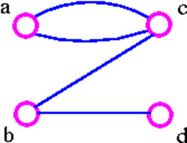
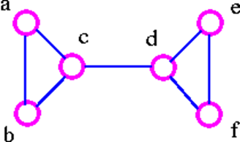

Continued….
The above graph $G_{1}$ can be split up into two components by removing one of the edges bc or bd. Therefore, edge bc or bd is a bridge.

Slide 4
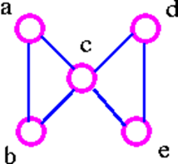

Continued….
The above graph $G_{2}$ can be disconnected by removing a single edge, cd. Therefore, edge cd is a bridge.
The above graph $G_{3}$ cannot be disconnected by removing a single edge, but the removal of two edges (such as ac and bc) disconnects it.

Slide 5
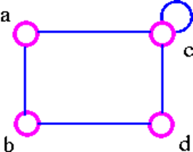
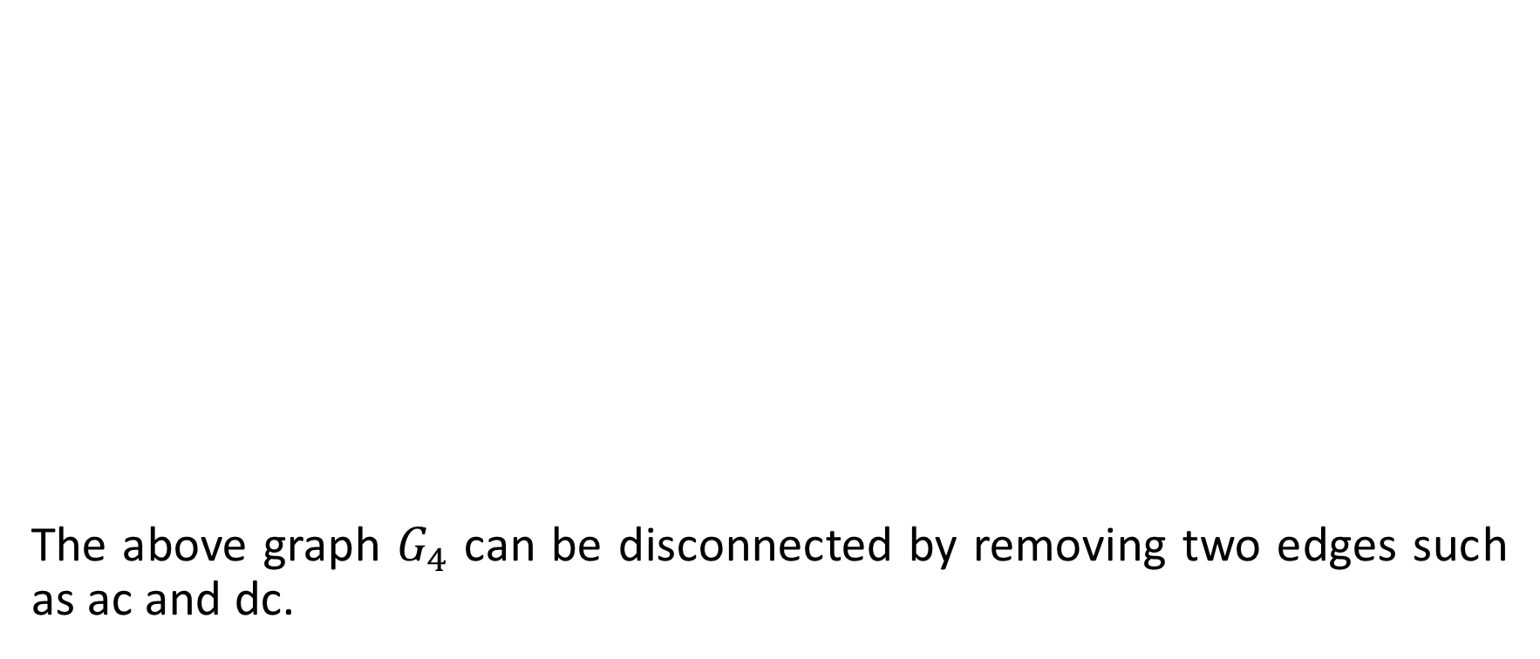
Continued….
The above graph $G_{4}$ can be disconnected by removing two edges such as ac and dc.

Slide 6
Vertex Connectivity
The connectivity (or vertex connectivity) K(G) of a connected graph G (other than a complete graph) is the minimum number of vertices whose removal disconnects G. When K(G) ≥ k, the graph is said to be k-connected (or k-vertex connected). When we remove a vertex, we must also remove the edges incident to it. As an example consider following graphs.

Slide 7
Continued….
The above graph G can be disconnected by removal of single vertex (either b or c). The G has connectivity 1.
The above graph G can be disconnected by removal of single vertex (either c or d). The vertex c or d is a cut-vertex. The G has connectivity 1.

Slide 8
Continued….
The above G can be disconnected by removing just one vertex i.e., vertex c. The vertex c is the cut-vertex. The G has connectivity 1.
The above G cannot be disconnected by removing a single vertex, but the removal of two non-adjacent vertices (such as b and c) disconnects it. The G has connectivity 2.

Slide 9
Trees
An acyclic graph (also known as a forest) is a graph with no cycles. A tree is a connected acyclic graph. Thus each component of a forest is tree, and any tree is a connected forest.
The following are equivalent in a graph G with n vertices.
G is a tree.
There is a unique path between every pair of vertices in G.
G is connected, and every edge in G is a bridge.
G is connected, and it has (n - 1) edges.
G is acyclic, and it has (n - 1) edges.

Slide 10
Continued….
G is acyclic, and whenever any two arbitrary nonadjacent vertices in G are joined by and edge, the resulting enlarged graph G' has a unique cycle.
G is connected, and whenever any two arbitrary nonadjacent vertices in G are joined by an edge, the resulting enlarged graph has a unique cycle.
Generally speaking, algorithms associated with trees can be divided into three types.
Algorithms for searching and labeling a given tree.
Algorithms for constructing various types of tree.
Algorithms for counting trees of a particular type.

Slide 11
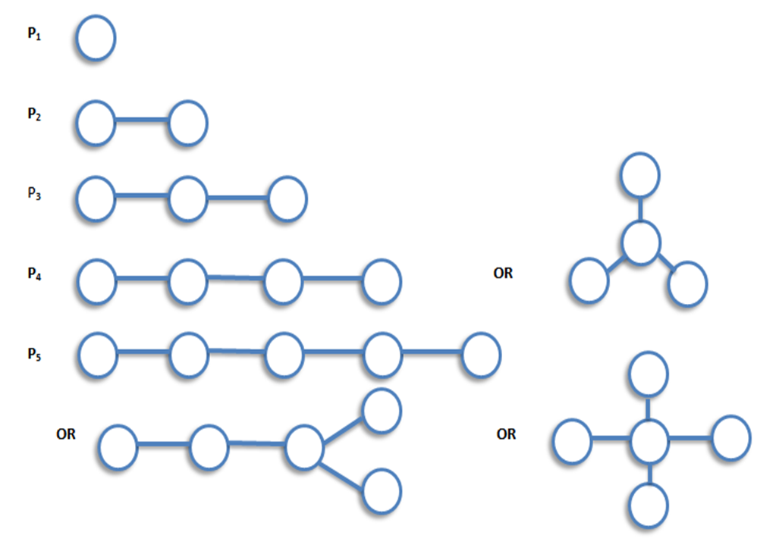
Tree
A tree is a connected graph which contain no cycles.

Slide 12
Continued…
Let T be a graph with n vertices. Then the following statements are equivalent.
T is connected and contains no cycles.
T is connected and has n-1 edges.
T has n-1 edges and contains no cycles.
T is connected and each edge is a bridge.
Any two vertices of T are connected by exactly one path.
T contains no cycles, but the addition of any new edge creates exactly one cycles.

Slide 13
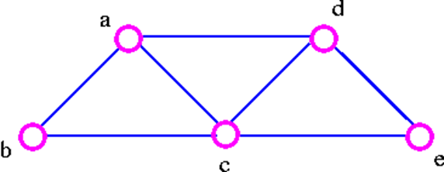
Spanning Trees
Let G be a connected graph. A spanning tree in G is a subgraph of G that includes all the vertices of G and is also a tree. The edges of the trees are called branches.
For example, consider the following graph G
The three spanning trees G are:

Slide 14
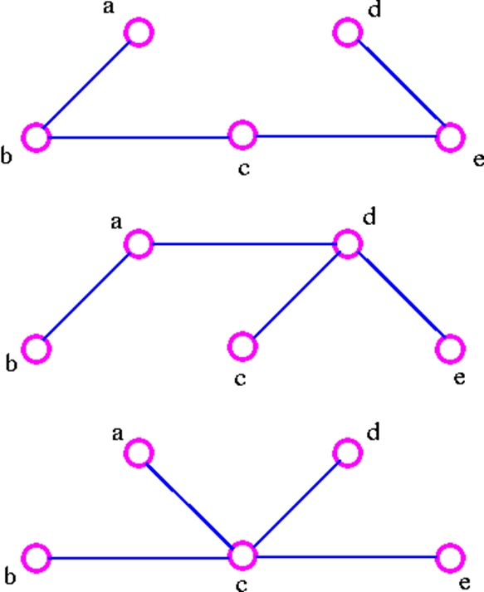
Continued….

Slide 15
Continued….
We can find a spanning tree systematically by using either of two methods.
Cutting-down Method
Start choosing any cycle in G.
Remove one of cycle's edges.
Repeat this procedure until there are no cycle left.
For example, given the graph G

Slide 16
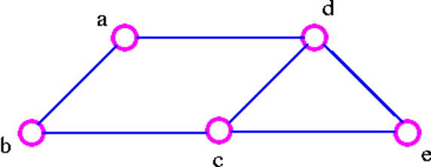
Continued….
1. We remove the edge ac which destroy the cycle adca in the above graph and we get

Slide 17
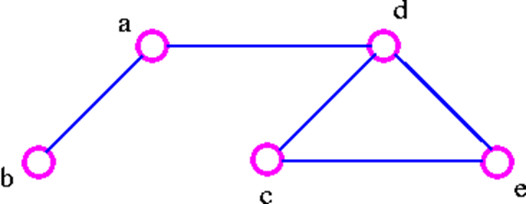
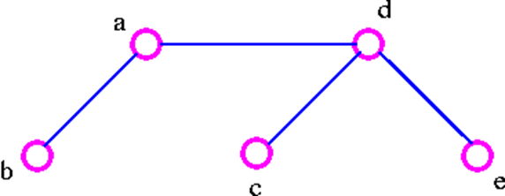
Continued….
2. We remove the edge cb, which destroy the cycle adcba in the above graph and we get
3. We remove the edge ec, which destroy the cycle decd in the above graph and thus obtained the following spanning tree.

Slide 18
Building-up Method
Select edges of G one at a time. in such a way that no cycles are created.
Repeat this procedure until all vertices are included.
For example, for the following graph G

Slide 19
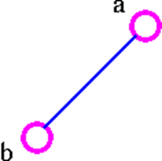
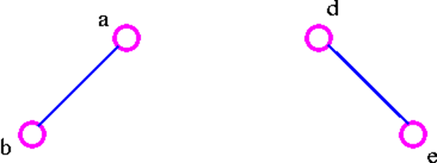
Continued…..
Choose the edge ab
Next choose the edge de as follows:

Slide 20
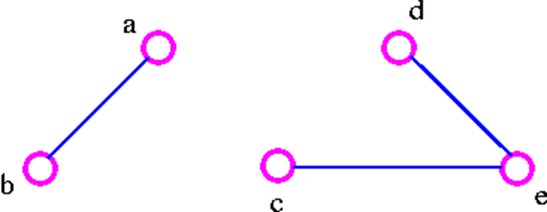
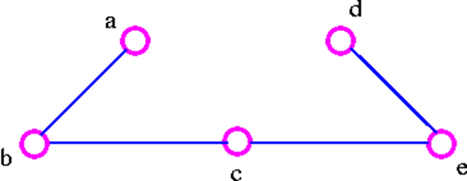
Continued…..
3. After that choose the edge ec as follows:
4. Finally, we choose the edge cb and thus obtain the following spanning tree.

Slide 21
Theorem: A graph is connected if and only if it has a spanning tree.
Proof: Let G be a connected graph. Delete edges from G that are not bridges until we get a connected subgraph H in which each edge is a bridge. Then H is a spanning tree.
Conversely, if there is a spanning tree in G, there is a path between any pair of vertices in G; thus G is connected. Proved.

Slide 22


